Slide 1
INSTRUCTOR BRIEFING · 25 SEPTEMBER 2026
Seed-dependent verdicts
A calibrated audit of attention-based binding-site explanations in drug–target interaction models
NAMING NOTE
5 models · 2 datasets
Our in-house model, ColdSite-DTI in the code repository, is called XAttn-Ref in the paper.
84 trained models · 28 setups × 3 seeds
Mahim · Supervisor: Dr. Chandra Mohan Dasari
Notes:
SAY: This paper checks whether AI models for drug discovery really show us where a drug binds, as their papers claim. One naming note first: our own model, which you knew as ColdSite-DTI, is now called XAttn-Ref. We renamed it on purpose. It is not the hero of this paper. It is one of the models under test, and it gets exactly the same treatment as the others. In total we trained 84 models: 28 combinations of model, dataset and split level, each trained with three different random seeds, on two standard datasets, DAVIS and KIBA. IF ASKED "Isn't it a conflict of interest to audit your own model?": That is why we renamed it neutrally and trained and scored it exactly like the others. We report its bad results too: at the residue level its attention is at chance, and on KIBA cold-drug its pocket enrichment is exactly 1.00, which is chance.

Slide 2




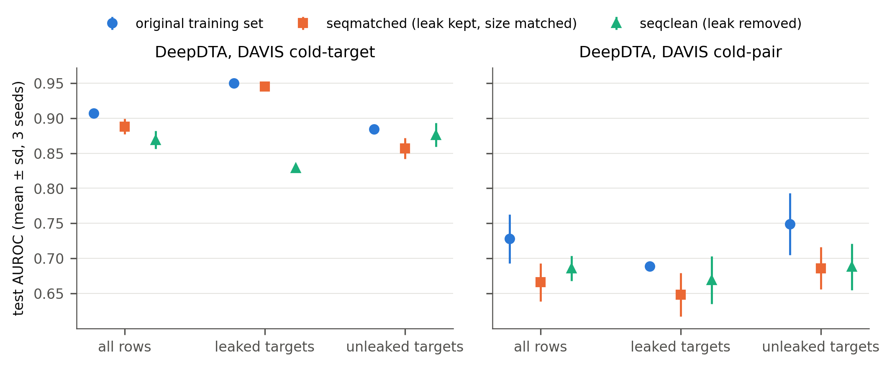
THE PROBLEM
One attention map from one run is not evidence
One run
No yardstick
Hidden recipe
Leaky tests
The map comes from one training run. A second run is never checked.
Hit rates are not compared with chance or corrected for many tests.
Nobody states how the attention tensor became one score per residue.
DAVIS marks proteins “unseen” by name, not by sequence.
The leak, measured (Figure 6)
54 DAVIS mutants carry the normal sequence, so 12 of 88 “unseen” cold-target proteins are seen in training.
DeepDTA, cold-target split, retrained without the leak: on the leaked rows the sequence match inflates AUROC by +0.116 (p = 0.0013). On the strictly unleaked rows no inflation is detectable (−0.019, p = 0.31).
Sources: draft §1, results/sequence_audit_davis.md, results/certification/step3_leak.txt
2 / 10
Notes:
SAY: Here is the problem in plain terms. Drug-target AI models often show a heat map over the protein and say "look, it found the binding site." But there are four gaps. First, that map comes from one training run, and nobody checks whether a second run gives the same map. Second, the hit rate is rarely compared with what random guessing would score. Third, the map is really a big multi-layer tensor, and the papers don't say how they reduced it to one number per residue. Fourth, the standard benchmark leaks. In DAVIS, 54 mutant proteins carry exactly the normal protein's sequence. So 12 of the 88 "unseen" test proteins in the unseen-target split are actually seen in training. IF ASKED "The DAVIS problem is already known.": Yes, and we cite it: DAVIS-complete (2025) and Ong et al. (2023). What we add is the size of the effect. We retrained DeepDTA, at the cold-target split only, without the leak and at the same training size. On the leaked rows the sequence match inflates AUROC by 0.116 (p = 0.0013, three seeds). On the strictly unleaked rows no inflation is detectable (minus 0.019, p = 0.31). We do not headline the all-rows figure of 0.019, because its interval, minus 0.022 to plus 0.059, includes zero.

Slide 3
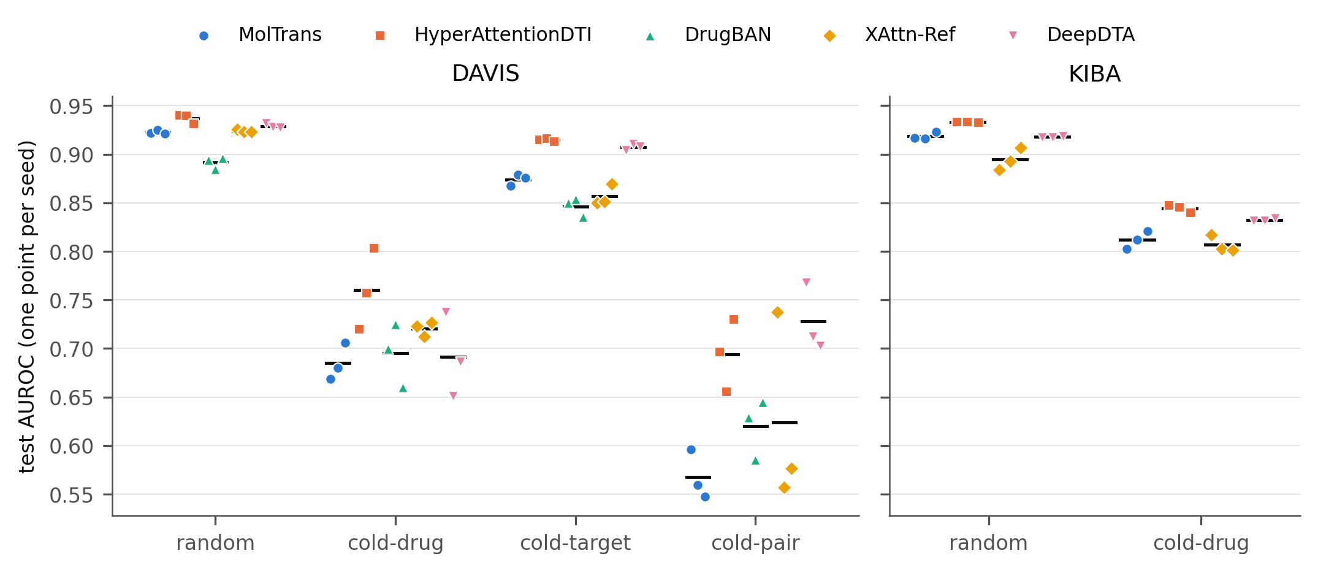
WHAT WE TESTED
Five models, one set of rules
Model | Year | Role | Attention scored?
DeepDTA | 2018 | Accuracy anchor (the baseline) | No: no attention
MolTrans | 2021 | Published model | Yes
HyperAttentionDTI | 2022 | Published model | Yes
DrugBAN | 2023 | Published model, DAVIS only | Yes
XAttn-Ref | ours | In-house reference model | Yes
Figure 3 · They trained properly. On DAVIS random, all five reach test AUROC 0.891–0.937.
Each published model uses its authors' own code and training settings. Only the data loading was replaced.
Sources: draft §2.2, Table 1, results/accuracy_v2/by_model.csv
3 / 10
Notes:
SAY: We tested four attention models, three published and one of ours, plus DeepDTA as a plain accuracy yardstick. We used each author's own code and training settings. The only thing we replaced was the data loading. Every model saw the same data splits. And before we judged any explanation, we checked that every model trained properly. On the standard random split they all score between 0.891 and 0.937 AUROC. So if an explanation fails, it's not because the model is broken. IF ASKED "Maybe you trained them badly?": We used the authors' code and settings, and random-split accuracy is in the normal range for DAVIS. We also caught and contained two defects in the published MolTrans code. One silently reset the random seed, so every seed trained as seed 1. We found it because three seeds gave identical scores, and we retrained. IF ASKED "These models are old.": They are the ones whose papers present attention maps as binding-site evidence, which is the claim we audit. Newer models are future work, and we say so.

Slide 4
OUR NOVELTY
The novelty is the method, not a new model
Same recipe, same data, different seed → different verdict.
Already done by others
What we add
Comparing attention maps with binding sites.
The verdict changes when only the random seed changes
A calibrated test battery: chance, ceiling, flat-map floor, positive control, nulls, Holm correction
The verdict depends on an unstated readout choice
The DAVIS leak, measured, not just reported
MONN (2020) · ICAN (2022) · InteractBind (2026, preprint)
Sources: draft §1 (contributions a–d), §4.2
4 / 10
Notes:
SAY: Our novelty is methodological. We did not build a better model. Other groups have already compared attention maps with binding sites: MONN, ICAN, InteractBind. What nobody had checked, as far as we found, is whether that verdict survives if you simply retrain with a different random seed. We measured this directly. Same code, same data, same settings, only the seed changes, and the verdict often flips. We also built a test battery that says when a verdict can be trusted, and we release the code so anyone can apply it. IF ASKED "Is this proven?": It is measured, not a theorem. To show that seed choice CAN flip a verdict, you need real cases where it happens, and we have 11. More seeds can tell us how often, but they cannot make those flips disappear. IF ASKED "ISAAC already reported seed stability.": ISAAC measures a different thing, intervention-based reasoning scores. Its scores were stable; our localisation verdicts are not. The two are complementary, and we say so in Discussion 4.2.

Slide 5
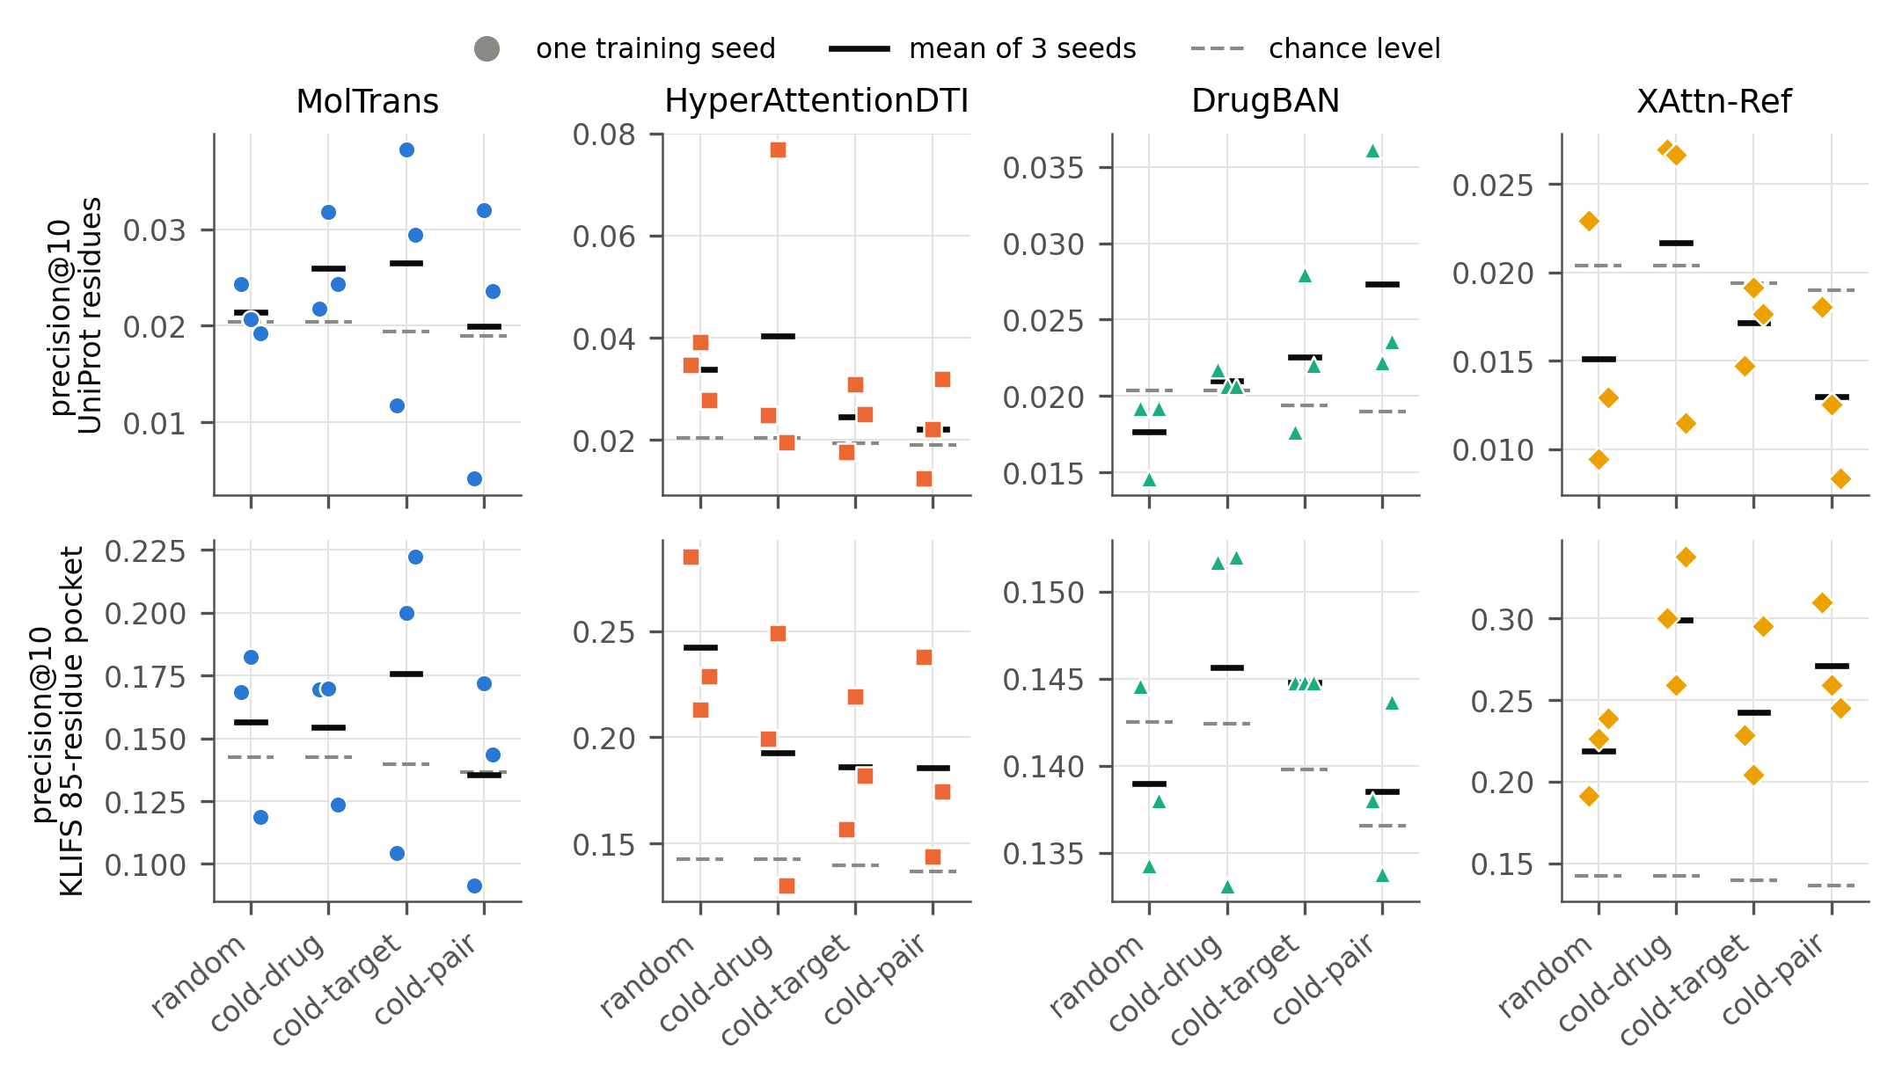
HARD RESULT 1 · THE DISAGREEMENT
Three seeds, three verdicts
11 of 22
cells where the three seeds fall on different sides of the α = 0.05 line
HYPERATTENTIONDTI · DAVIS COLD-DRUG
Seeds: 0.025 · 0.077 · 0.019
Chance: 0.020 · best run ≈ 4× the worst
All three seeds pass in 1 of 22 cells. None pass in 10 of 22.
The seeds' spread exceeds the distance from chance in 21 of 22 cells. Tested directly, seed variance is significant in 7 to 8 of 22 cells after Holm.
Figure 1 · precision@10 per seed (points) vs chance (dashed). DAVIS holds 8 of the 11 disagreeing cells; the other 3 are KIBA.
Source: results/certification/step1_disagreement.txt (exact per-seed p, α = 0.05)
5 / 10
Notes:
SAY: Here is the core evidence. We trained each model three times, changing only the seed. Then we asked each run the question a normal paper asks: does this map hit binding sites better than chance? In 11 out of 22 cases, the three runs don't agree: they fall on different sides of the usual 0.05 threshold. Some say yes, some say no. Look at HyperAttentionDTI here. Same recipe, and one run is about four times better than another. Two runs would let you publish a "significant" result, and the third would not. Only 1 cell out of 22 had all three seeds pass. 10 had none pass. The spread between seeds is bigger than the distance from chance in 21 of 22 cells, and when we test seed variance directly, with Friedman and permutation tests, 7 to 8 of 22 cells show significant differences between seeds even after Holm correction. IF ASKED "Is this just GPU hardware randomness?": Possibly in part, and we do not separate the two. A seed changes the starting weights and the batch order, and GPU non-determinism adds noise on top. But the practical point holds either way: a reader who reruns the published recipe can get the opposite verdict. That is exactly what a single-run figure hides. IF ASKED "Why an uncorrected test?": On purpose. It is what a single-seed paper would report. The strict corrected test is separate and harsher: only 1 of 20 DAVIS cells survives, using the median p over the three seeds. Tested seed by seed, 5 seed-runs survive. IF ASKED "Why 11 and not 12 like your earlier run?": The first run used 1,000 random permutations and one borderline seed, MolTrans random seed 1, had a sampled p of 0.049. The exact p-value is 0.056, so that cell moves to agreeing and the count is 11. IF ASKED "How do you know the seeds were really different?": The per-seed scores differ for every model in the table. The MolTrans seed bug is how we know we would notice if they didn't. From now on, the cloud harness records a hash of the starting weights for every seed.

Slide 6
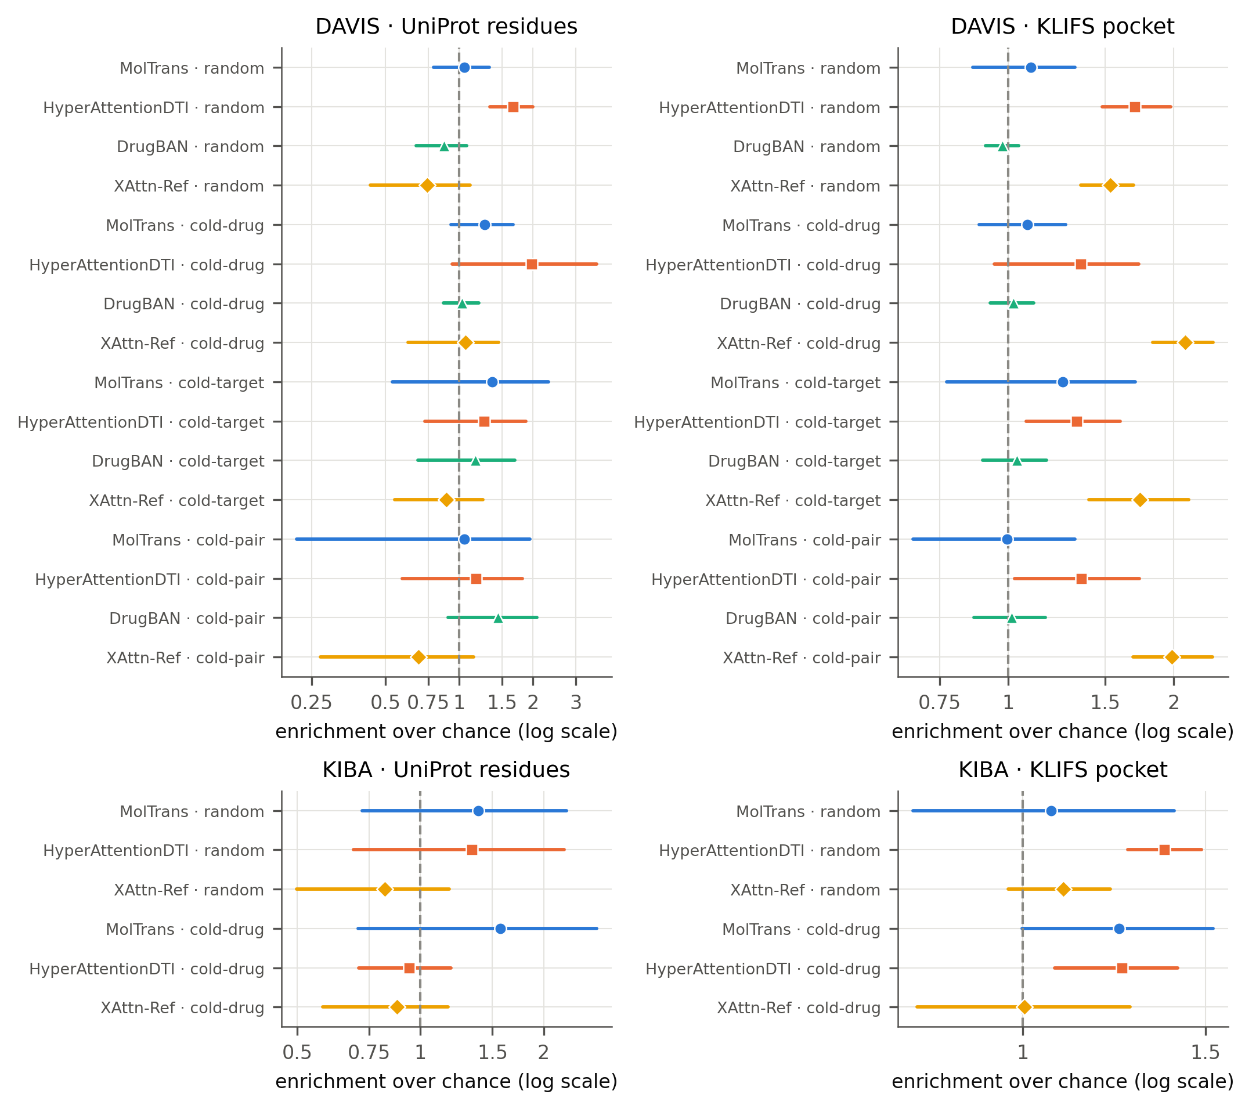
HARD RESULT 2 · THE TWO-WAY BOOTSTRAP
Counting seed variance shrinks the claims
The usual bootstrap resamples proteins only. Ours resamples proteins and seeds.
HYPERATTENTIONDTI · DAVIS COLD-DRUG · ENRICHMENT
Proteins only: 1.98 [1.81, 2.15], clear of chance
Proteins + seeds: [0.94, 3.65], crosses chance (1.0)
Cells above chance | Proteins only | Proteins + seeds
Residue level (UniProt) | 7 / 22 | 1 / 22
Pocket level (KLIFS) | 15 / 22 | 9 / 22
The one residue-level survivor, HyperAttentionDTI at DAVIS random (1.66 [1.33, 2.00]), is the same cell that passes the Holm-corrected test.
Figure 2 · Enrichment over chance, 95% two-way intervals
Sources: results/effects_v2/ (proteins only) vs results/effects_v2_2d/ (proteins + seeds), enrichment.csv
6 / 10
Notes:
SAY: The usual way to put error bars on these numbers resamples the proteins only. It treats one training run as the truth. So we built a two-way bootstrap that resamples both the proteins and the seeds. Watch what happens. This HyperAttentionDTI result looks rock solid with the usual method, nowhere near chance. Once seed variance is counted, the error bar crosses chance. Across the board, residue-level claims above chance drop from 7 to 1, and pocket-level claims drop from 15 to 9. The one residue-level claim that survives is the same one that survives our strict corrected test. The two methods agree. IF ASKED "Doesn't weakening your own results hurt the paper?": No, it IS the finding. If seed variance didn't matter, the intervals wouldn't move. They move a lot. IF ASKED "Did you add the 2D bootstrap after seeing the results?": Yes, and we say so. The protocol amendment specified the proteins-only version, and we keep it for comparison. The change can only make claims harder to pass, never easier. With three seeds the intervals are conservative, and the paper states that too. IF ASKED "What survives on the pocket?": XAttn-Ref at all four DAVIS levels, HyperAttentionDTI at three, one of them (cold-pair) only marginal. But there is no conservation control, so we call that coarse enrichment, not learned chemistry.

Slide 7
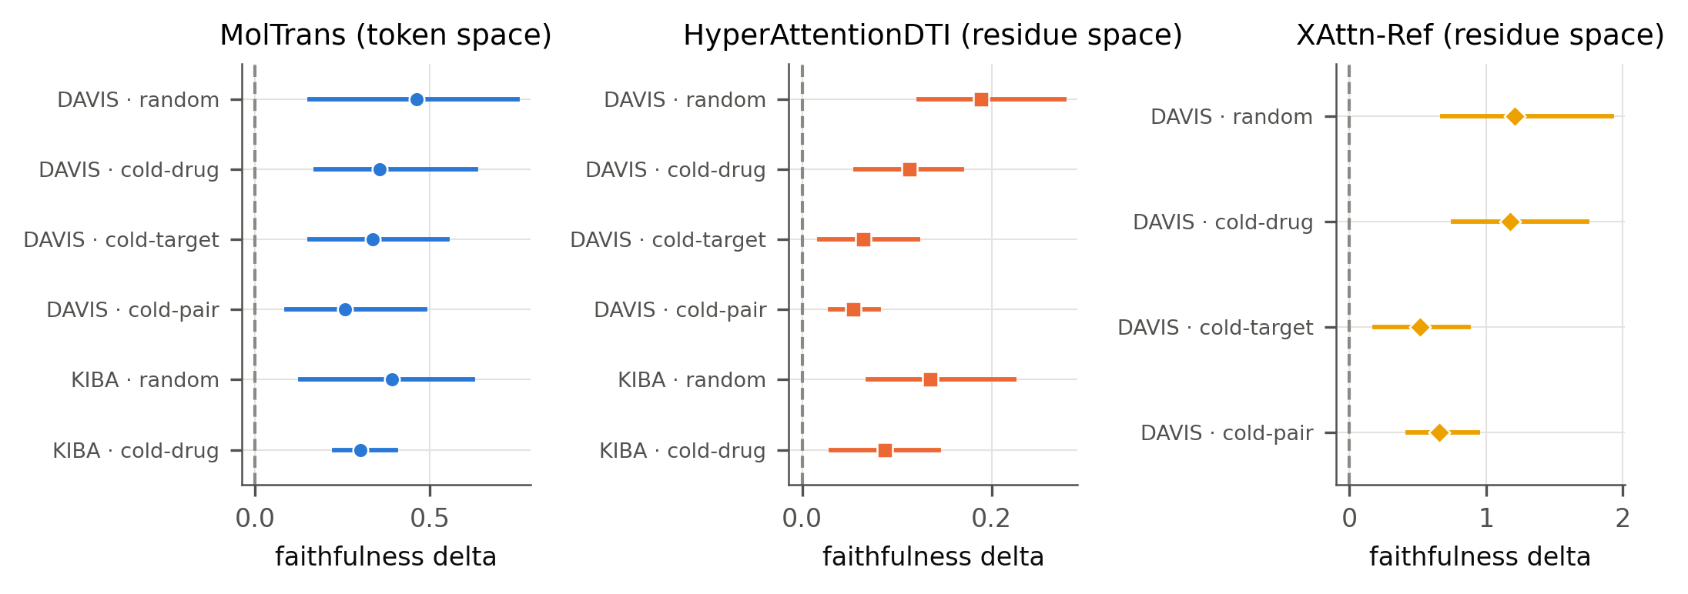
HARD RESULT 3 · FAITHFULNESS
Attention matters to three of four models, not DrugBAN
DrugBAN, DAVIS: two of four levels
Seed | Cold-drug | Cold-pair
1 | −0.0073 | −0.0037
2 | −0.0036 | −0.0038
3 | +0.0128 | +0.0027
6 of its 12 seed-level values are negative. All sit near zero, and the sign flips between seeds.
Figure 5 · Masking the attended residues minus masking the same number of random ones. 95% intervals, proteins and seeds resampled.
Point estimates only, so DrugBAN is not drawn in Figure 5. Other levels: see draft.
16 of 16
intervals above zero for HyperAttentionDTI, MolTrans and XAttn-Ref. Smallest: 0.054 [0.030, 0.080].
Sources: results/effects_v2_2d/faithfulness_effects.csv; faithfulness_drugban_davis_seed{1,2,3}.md
7 / 10
Notes:
SAY: Next question: does the model actually USE the residues it attends to? We mask the top ten attended residues and see how much the prediction changes, compared with masking ten random ones. For three models the answer is clearly yes, in all 16 cells, with every error bar above zero. DrugBAN is different, and we show its raw numbers so nothing is hidden. For seed 1, masking its attended residues changes the prediction by LESS than masking random ones: minus 0.0073 and minus 0.0037. For seed 3 the sign flips to plus: 0.0128 and 0.0027. All of these are close to zero. So DrugBAN's attention is not reliably load-bearing. IF ASKED "Why does DrugBAN have no error bars?": Its first analysis run saved only the averages, not the per-pair values. Re-running needs a graph library, DGL, that was not available on our analysis machine. The re-run is planned. So we report the point estimates openly instead of dropping DrugBAN. IF ASKED "Why is MolTrans on a different scale?": It reads proteins as multi-residue word pieces, so we mask in its own token space. The control is size-matched, but the magnitudes are not comparable with the other models.

Slide 8
THE SOLUTION · BOX 1
An eight-point reporting checklist
1
Report several seeds and their agreement
5
State the readout: heads, layers, pooling
11 of 22 cells: seeds disagree
Same weights: 0.367 vs 0.081 in the pocket
2
Read hit rates against chance and ceiling
6
State what inputs the map depends on
Residue chance is only 0.019–0.020 on DAVIS
MolTrans readout scored: same top ten for every drug
3
Add a flat-map floor and positive control
7
Test faithfulness with size-matched masks
Detects a 0.02 dose at every DAVIS level
DrugBAN: the sign flips between seeds
4
Correct for multiple comparisons
8
Check “unseen” splits by sequence
1 of 20 DAVIS cells survives Holm (median p over seeds)
12 of 88 “unseen” proteins seen in training
Blue line under each item: the finding in our data that makes it necessary. Source: draft Box 1
8 / 10
Notes:
SAY: Here's what we propose to fix this. Eight simple checks, and every one comes from something that changed a verdict in our data. The blue line under each item is that finding. The two biggest: report more than one seed, and compare against chance with a proper correction. Both are cheap compared with training, and our released code does them automatically for any model that gives one score per residue. IF ASKED "Isn't this obvious?": Each item is there because skipping it changed a result. Example: two reasonable ways of reading the SAME HyperAttentionDTI weights put 0.367 and 0.081 of the top ten residues in the pocket, against a chance of 0.140. One says 2.6 times chance, the other says below chance. And the MolTrans readout we scored gives the same top ten for every drug in 100% of drug pairs, so that readout cannot mark a particular drug's binding site. MolTrans's interaction map is a different readout and does vary with the drug, so the claim is about the readout, not the whole model.

Slide 9





WHAT IS LEFT · WAVE A COMPUTE
30 training jobs: planned, split and gated
ACCOUNT 1 · 12 CELLS
ACCOUNT 2 · 12 CELLS
ACCOUNT 3 · 6 CELLS
Seed 4 × HyperAttentionDTI, MolTrans, XAttn-Ref × 4 DAVIS levels
Seed 5 × the same three models × 4 DAVIS levels
DrugBAN × KIBA × 2 levels × seeds 1–3
23.2 GPU-hours (21.8–24.7)
23.2 GPU-hours (21.8–24.7)
Hours not yet measured: timing run first
Done: notebooks built
→
Done: dry-run checks pass
→
Next: canary must match an old result
→
Next: DrugBAN timing run
→
Then: launch
Quota: 30 GPU-hours per week per account. Accounts 1 and 2 need 27.3 (mean) to 29.1 (high case), including a 15% reserve. No Wave A result appears in any number in the paper.
Sources: docs/wave_plan.md, config/wave_budget.json (hours from measured T4 speeds)
9 / 10
Notes:
SAY: Two gaps remain, and we planned both before seeing any of their results. First, three seeds is a small number, so we will add seeds 4 and 5 for three models. Second, DrugBAN has no KIBA results yet. That's 30 training jobs split across three Kaggle accounts. Each job is assigned exactly once, and the hours are estimated from measured training speeds, not guesses. The seed jobs need about 23 GPU-hours per account, which fits the weekly quota with a safety margin. The notebooks are built and pass their checks. On purpose, they won't start training until a canary run reproduces one of our existing results. None of this future work is in any number in the paper. IF ASKED "Why hasn't it run yet?": Deliberate gating. If the new cloud harness changed the numbers, we would rather know before spending about 46 GPU-hours. The canary checks that first. IF ASKED "How long will DrugBAN take?": We don't know yet, and we won't guess. No timing record exists, so a short timing run comes first. The plan says so. IF ASKED "Will seeds 4 and 5 change your headline?": They are a separately declared family, reported beside the original results, not merged in. They can refine how often seeds disagree, but they cannot undo the 12 disagreements we already observed.

Slide 10
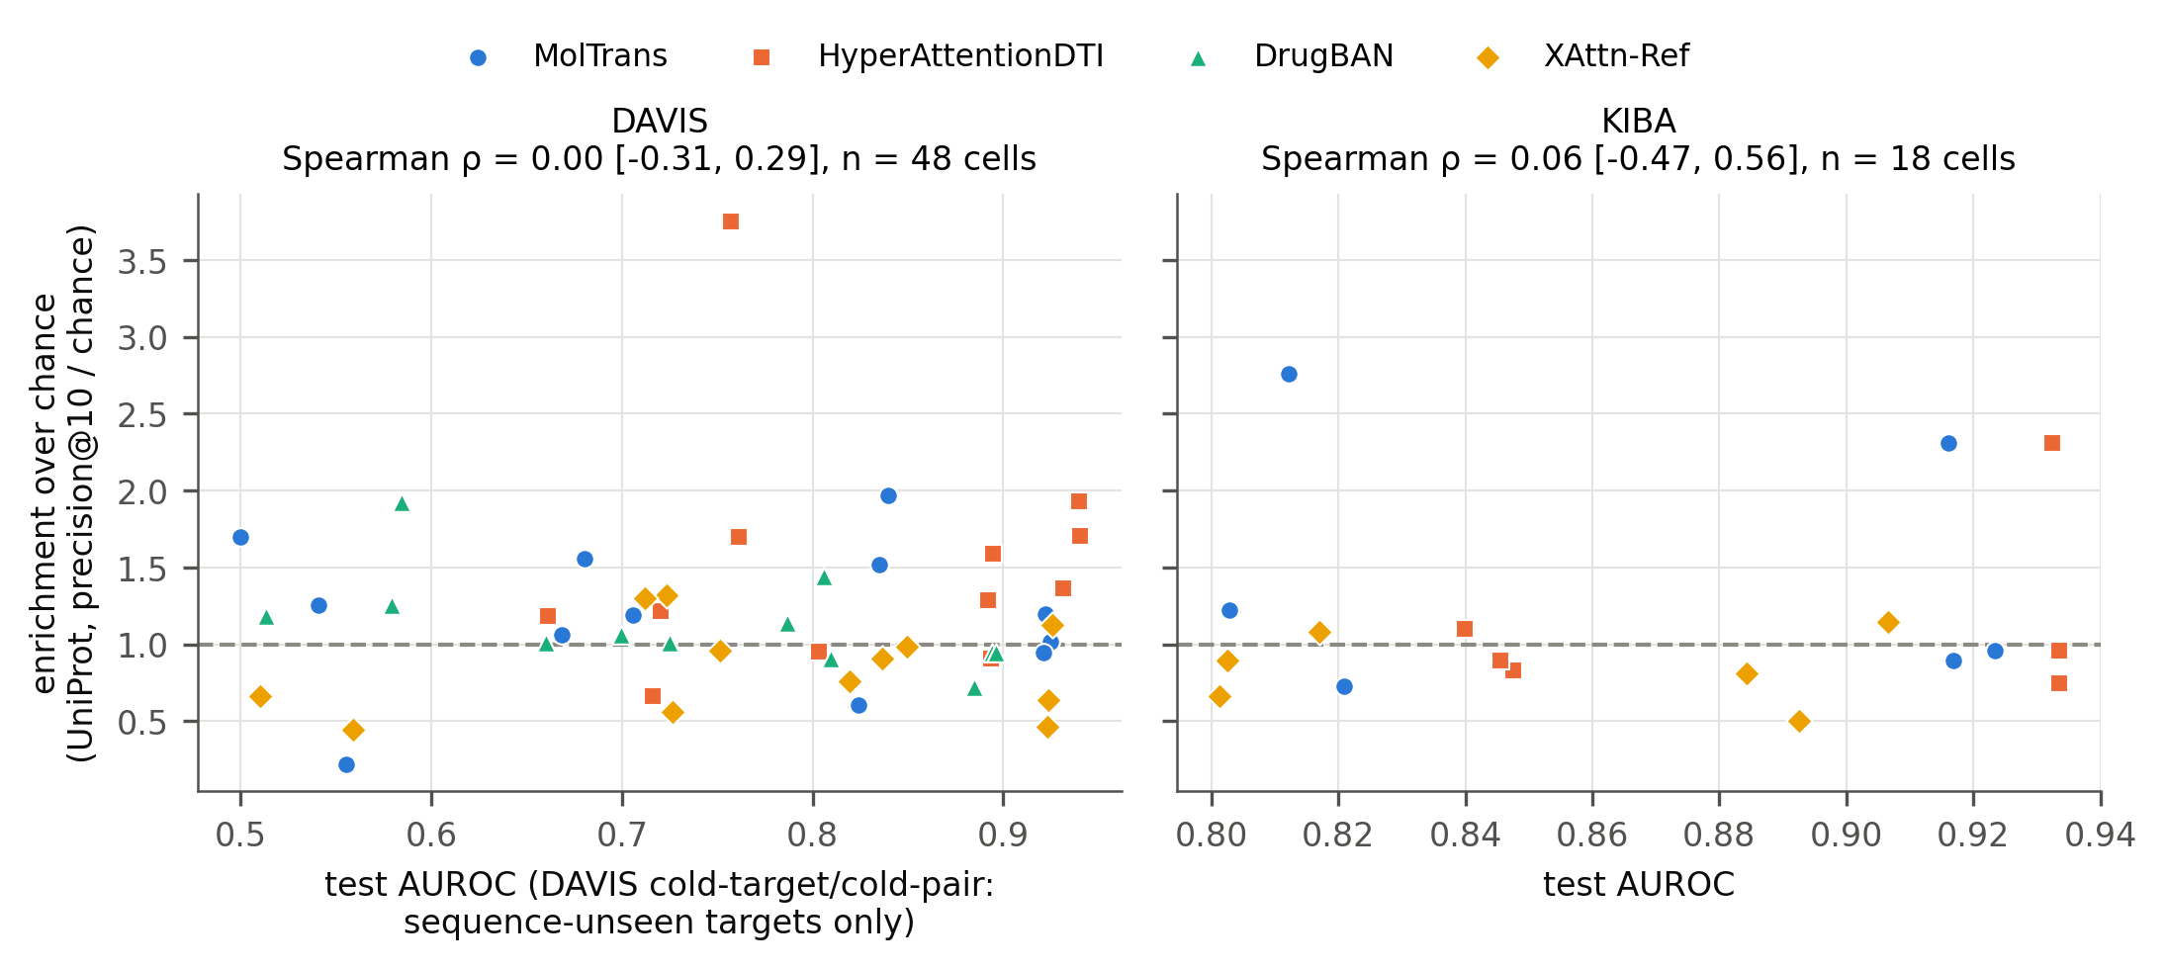



CONCLUSION
One attention map cannot carry a binding-site claim
Residue-level claims rarely survive
1 of 20 DAVIS cells, 0 of 8 KIBA cells after correction
Verdicts are unstable
Seeds disagree in 11 of 22 cells
What holds is coarser
Load-bearing in 3 of 4 models; pocket enrichment for 2
Figure 4 · Better accuracy does not mean better localisation: Spearman ρ = 0.003 [−0.309, 0.294] over 48 DAVIS cells.
The benchmark leaks
The fix: an eight-point checklist
12 of 88 “unseen” proteins seen in training
Eight checks, each from a finding in our data
84 trained models · 1,202 passing tests · 986 numbers in the draft machine-checked against their source files, 0 failures
10 / 10
Notes:
SAY: To sum up. For the models we tested, a single attention figure can't support a claim that the model found the binding site. The verdict changes between seeds, it rarely survives a proper test, and it depends on choices papers don't report. What DOES hold up is coarser: three of the four models really do use what they attend to, and two focus on the kinase pocket at most levels. And as Figure 4 shows, a more accurate model is not a better localiser. Our message to the field is simple: use several seeds, compare with chance, correct your tests, state your readout, and check your splits by sequence. Two things sit beside the results. The benchmark itself leaks: 12 of the 88 "unseen" proteins were seen in training by sequence, and for the baseline we retrained the sequence match inflates AUROC on those rows by 0.116 (p = 0.0013), with no detectable inflation on the truly unseen rows. And the fix is the eight-point checklist on slide 8: each item exists because skipping it changed a result in our data. Every number in this paper is automatically traced back to the file it came from. IF ASKED "Isn't this just a negative result?": It is a negative result with a positive tool. The checklist and the released code let anyone test their own model before publishing. IF ASKED "Does it apply beyond kinases?": We don't claim it does. Both datasets are kinase panels, and we scope every claim to kinases.

